Slide 1
Data visualization approaches to presenting harms in clinical trials
Riaz Qureshi, PhD, MSc
Assistant Professor
Dept. of Ophthalmology
University of Colorado Anschutz Medical Campus

Slide 2
Disclosures
No disclosures
2
Notes:
So where does visualization come in? How can it possibly help these issues? The common approach to reporting harms is exactly as we saw in that example, to use a table with an estimate or maybe simple counts of the number of times each of the “most common” or selected harms was reported in the trial.
We know that patients and clinicians want more information about harms than they are currently getting. Both in terms of the numbers and types of harms, and other dimensions like the timing or severity of the harms.
Data visualization has the capacity to provide more dimensions of harms data in a single figure to patients and clinicians which can present a more holistic and complete summary of harms data in publications that is not as restrictive as the current approach using tables. But how can we assess whether there is any value in this?

Slide 3
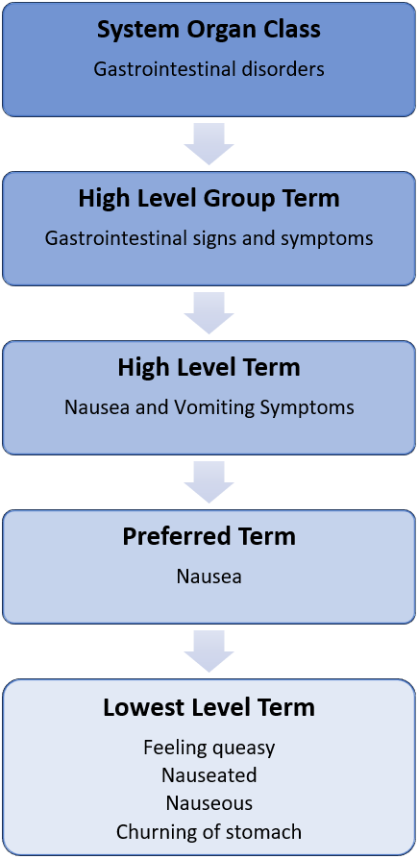
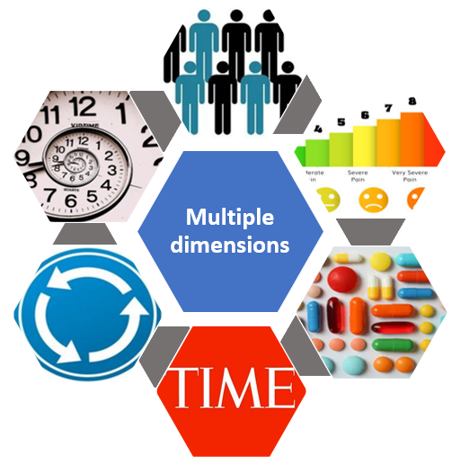
Hierarchical terminology and multi-dimensionality
ICH 2021; Andrews 2016; Fizames 1997; Tremmel 2001; ICH 2016; Ma 2016; Cornelius 2020; Phillips 2020
3

Slide 4
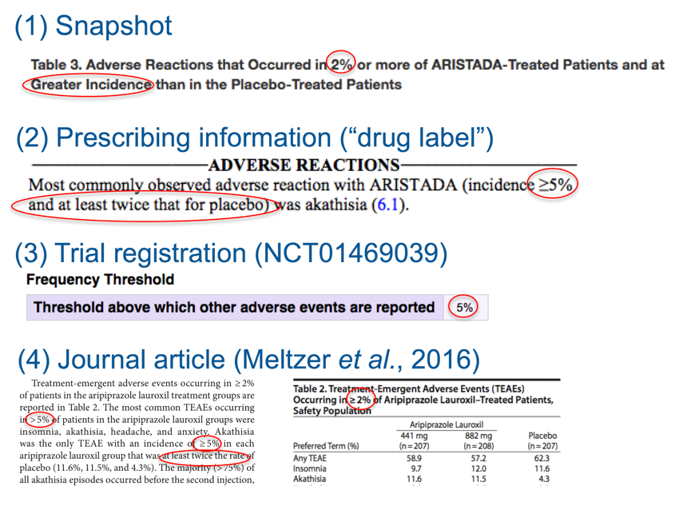
Selection criteria
Rules that determine which harms will be reported in a given publication
Inconsistent criteria across reports for any given study
NCT01468039; FDA 2015; Meltzer 2016
4
Notes:
When I describe harms meeting some selection criteria, these are the rules that dictate which harms will be reported in any given publication. Many harms are collected over the course of a study and yet most are never reported in a publication. Another challenge that arises from the use of selection criteria is that they can be inconsistent across sources for the same trial, as in this example. Here we can see that we are getting data on harms occurring in 2% or more of Aristada-treated patients and at greater incidence than in the placebo group, or harms that occurred in at least 5% of Aristada patients and at least twice as common among placebo. This variability makes it difficult to know what was really collected in a trial unless we have the un-published data.

Slide 5
Visualization approaches to harms
Harms data are incomplete and truncated/summarized for publication
Presented as counts
Highly selected harms meeting specific criteria
Patients and clinicians want more information than they are getting
To understand the full picture of potential harms, people need other aspects of the harms
Berry 1998; Buchter 2014; Berry 2002; Enlund 1991; Lang 2016; Entwistle 2005; Duclos 2005; Tarn 2015; Basch 2010; Berry 2003; McNeal 2010; Franklin 2013
5
Notes:
So where does visualization come in? How can it possibly help these issues? The common approach to reporting harms is exactly as we saw in that example, to use a table with an estimate or maybe simple counts of the number of times each of the “most common” or selected harms was reported in the trial.
We know that patients and clinicians want more information about harms than they are currently getting. Both in terms of the numbers and types of harms, and other dimensions like the timing or severity of the harms.
Data visualization has the capacity to provide more dimensions of harms data in a single figure to patients and clinicians which can present a more holistic and complete summary of harms data in publications that is not as restrictive as the current approach using tables. But how can we assess whether there is any value in this?

Slide 6
What we did
6 visualizations for presenting multiple emerging adverse events
Dot Plot, Bar Chart, Volcano Plot, Heatmap, Treemap, Tendril Plot
Trial with Individual Participant Data on harms from the Multiple Data Sources in Systematic Reviews (MUDS) Study
Compared visualization characteristics and “value”
https://github.com/rquresh/HarmsVisualization
Phillips 2019
6
Notes:
A recent scoping review of analysis methods for harms in clinical trials included a subsection for visualization approaches for harms. There were six visualizations that fit our purpose and what we wanted to assess: specifically, visualizations for multiple adverse events that presented some effect measures and multiple dimensions of data.
We took these and reproduced them using R and the individual participant data from a trial of gabapentin for neuropathic pain from the MUDS study. We have made this R code available on github and it includes example data structure set-up so that trialists may easily implement any of these visualizations with their own data.
I’m going to show the 6 visualizations that we created and then I am going to take some time to explain each of them in a bit more detail.

Slide 7
7
Notes:
Here are the six data visualization approaches that we assessed for emerging harms.
The left column has a Volcano Plot above and a Tendril Plot below. The top middle visualization is a Dot Plot with a Bar chart (or Stacked Bar chart) beneath that. And on the right is a Heatmap on top with a Treemap on the bottom right.
All six of these visualizations are presenting the same harms data from a trial of gabapentin for neuropathic pain, just in different ways and sometimes different dimensions of the data.

Slide 8
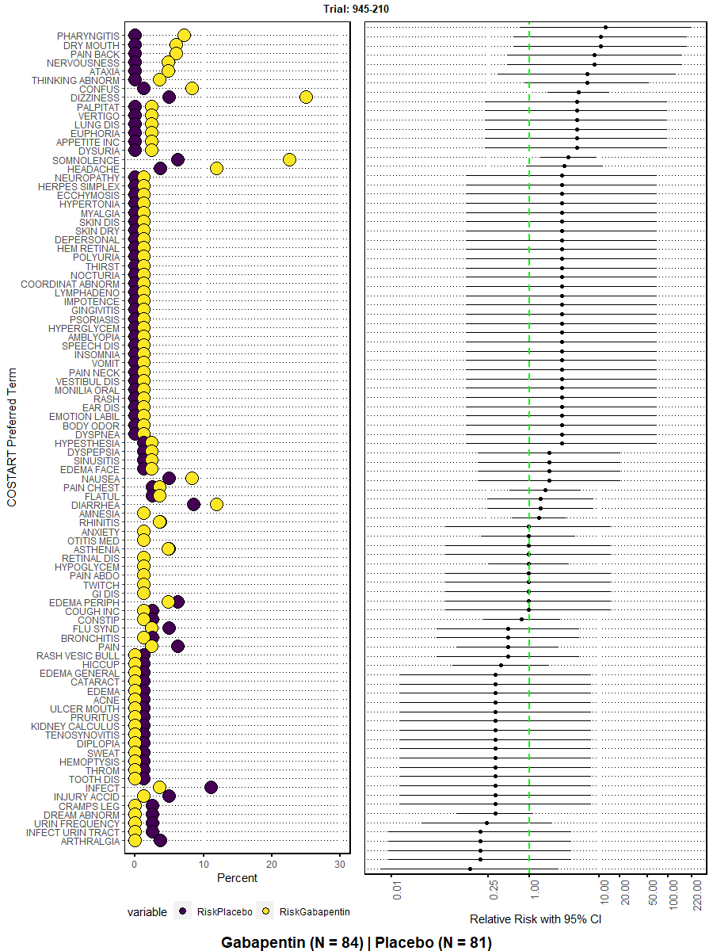
Dot plot
Preferred terms
Incidence by arm
Effect measure (Relative Risk)
95% confidence interval
8
Notes:
A Dot Plot is a presentation of harms data at the level of the preferred term, arranged by descending effect size, and includes both an estimate of the incidence in each arm and a measure of effect of choice (in this case, Relative Risk). Every recorded harm is shown and the summary estimates include their 95% confidence intervals, with the measure of effect being presented on the logarithmic scale and a green line to indicate the boundary for "no effect."

Slide 9
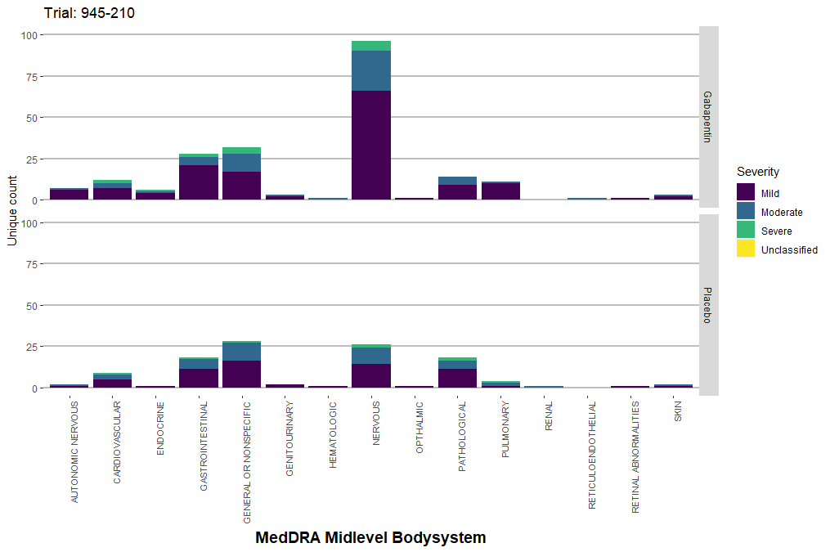
Bar chart
Higher-order terms
Absolute counts by arm
Distribution of severity
COSTART Midlevel Bodysystem
9
Notes:
A Bar Chart presents data on harms only at the midlevel body system as opposed to the preferred term level and displays the number of occurrences within each body system by treatment arm (i.e., gabapentin and placebo). The distribution of severity of harms within each body system are also presented by the different colours.

Slide 10
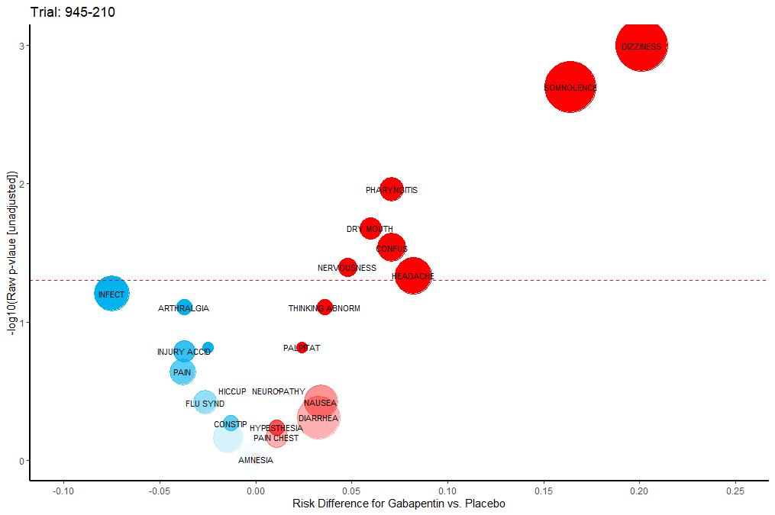
Volcano plot
Preferred terms
Effect measure (Risk Difference)
P-value
Absolute count overall
P = 0.05
10
Notes:
A Volcano Plot presents all harms at the preferred term level as bubbles with the -log10 P-value plotted against the risk difference. Harms higher on the y-axis and darker in colour, have smaller p-values than lower and lighter harms. "0" on the x-axis is the boundary of no effect, such that harms with positive risk differences are more common among participants receiving gabapentin; this is also represented by the colour (i.e., red = more common in gabapentin, blue = more common in placebo). The size of the bubbles is proportional to the total number of events.

Slide 11
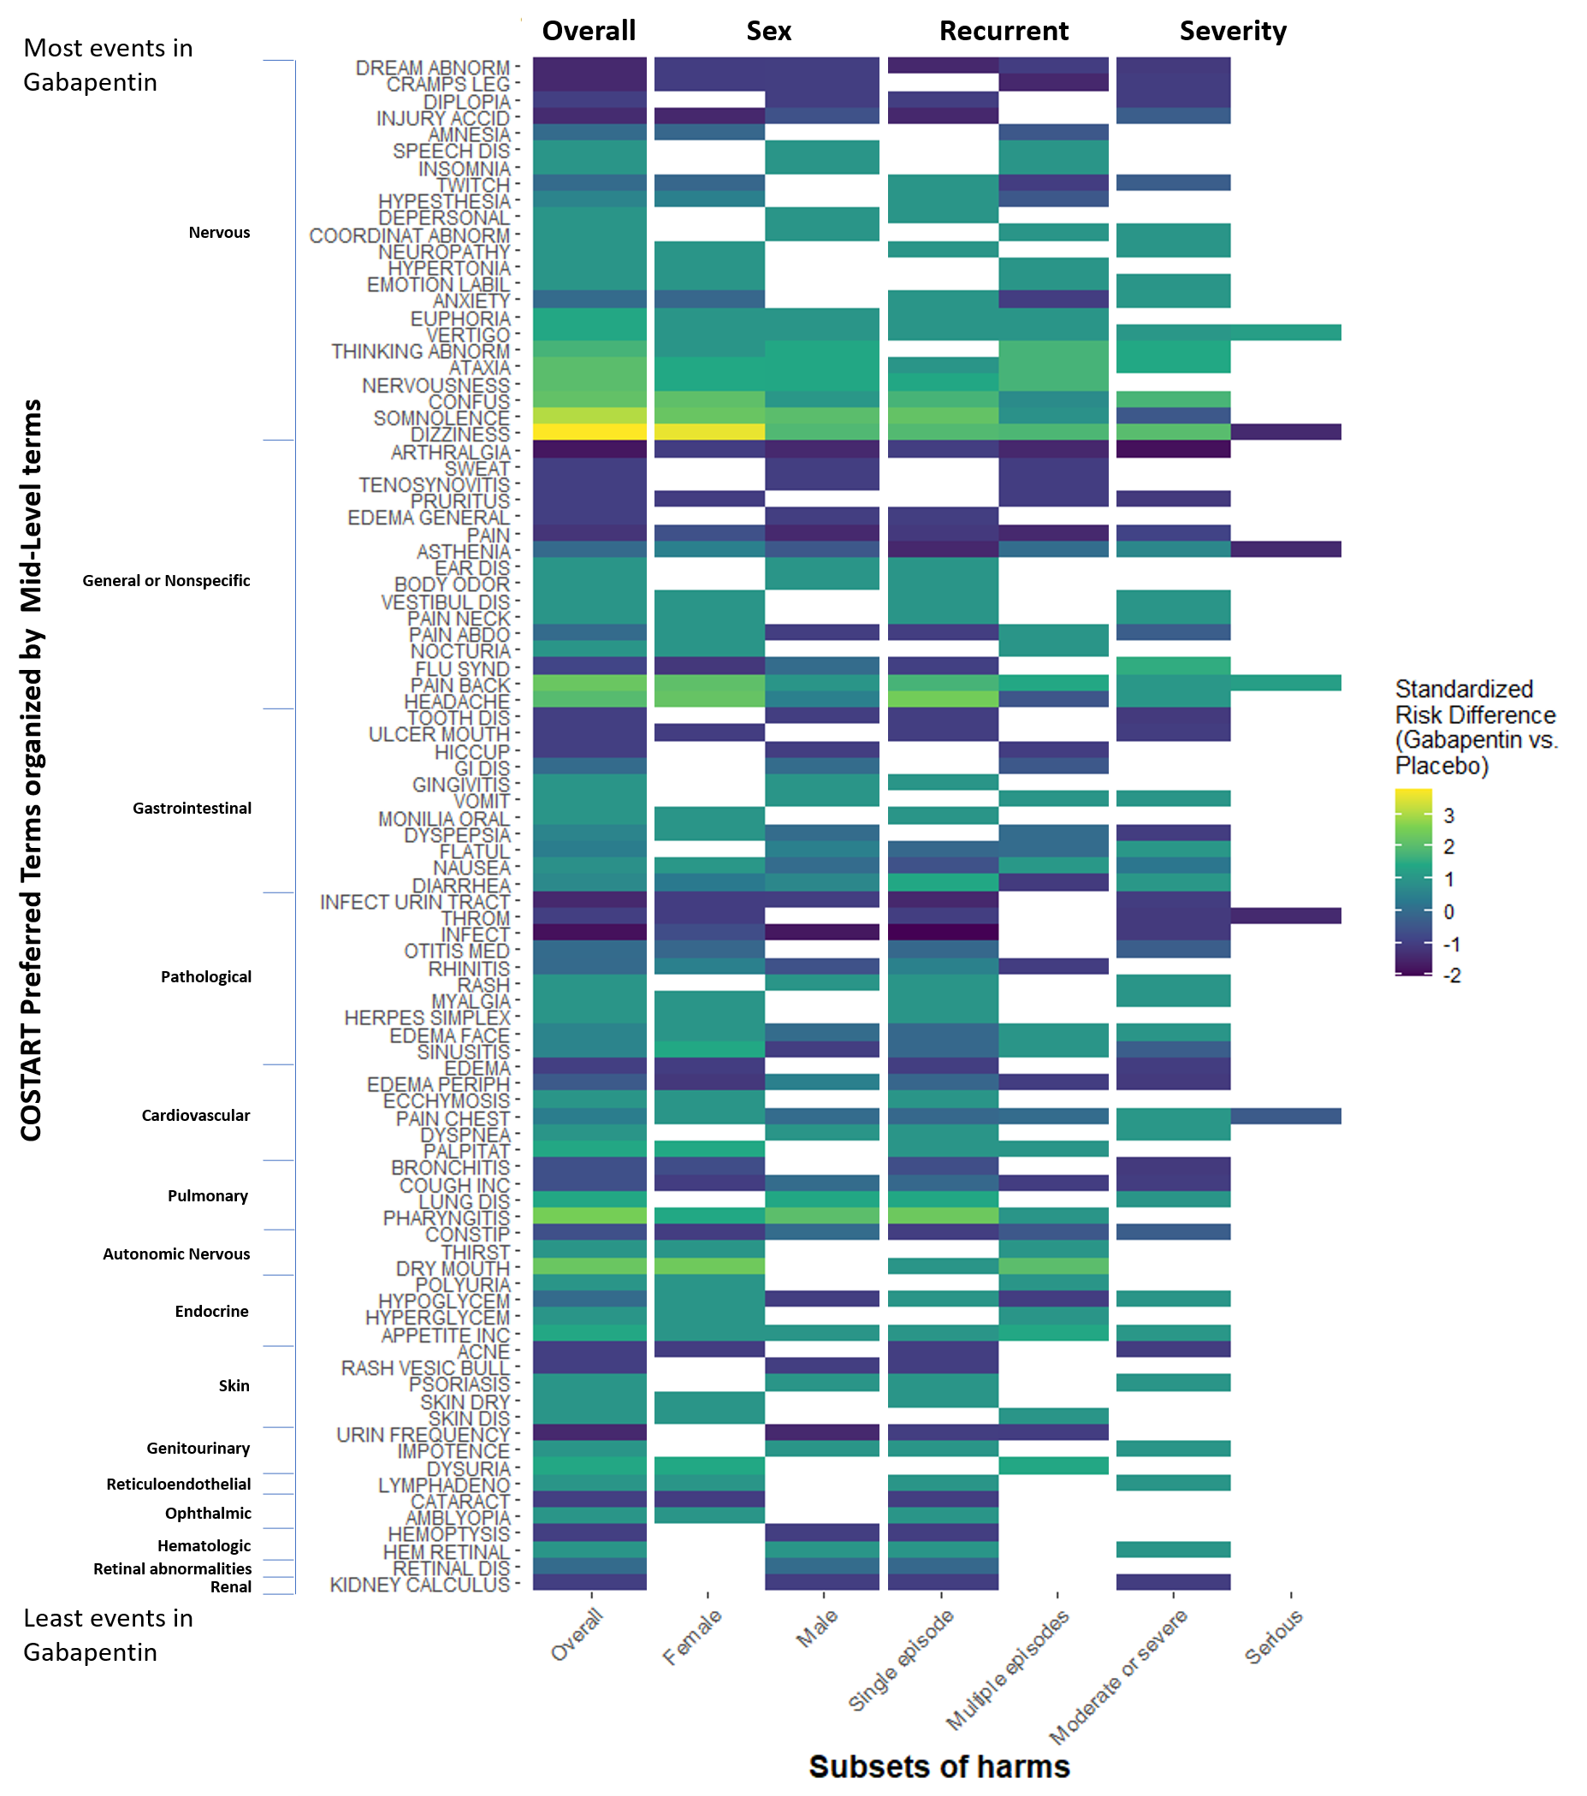
Heatmap
Subsets of harms
Preferred terms
Effect measure (Standardized Risk Difference)
Higher-order terms
Absolute count for gabapentin
11
Notes:
A Heatmap presents the standardized risk difference for harms overall and for harms that meet specific criteria of interest (e.g., only harms occurring in females or males, or only severe or serious harms) at the preferred term level. The specific harms are grouped by their midlevel classifications and sorted within midlevel body system by increasing effect size. The midlevel body systems are sorted by decreasing number of events in the gabapentin group.

Slide 12
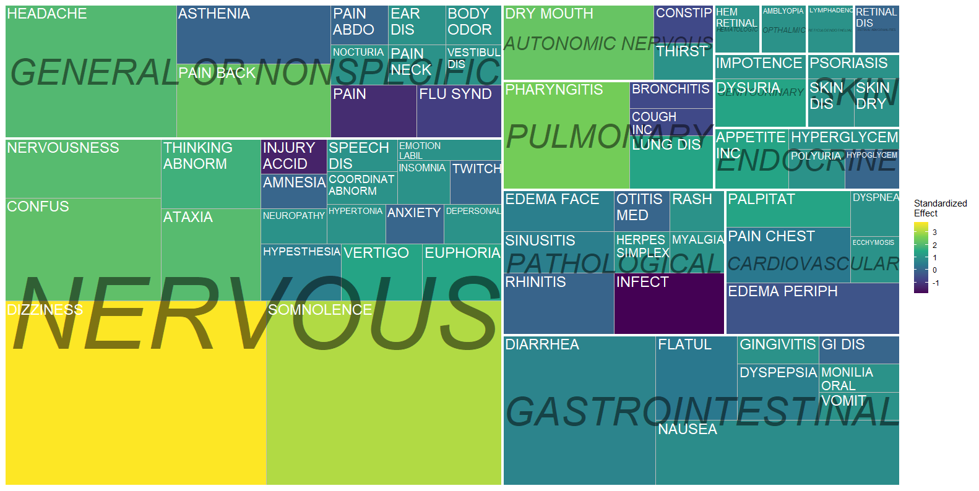
Heatmap alternate (Treemap)
Preferred terms
Effect measure (Standardized Risk Difference)
Higher-order terms
Absolute count for gabapentin
12
Notes:
A Treemap is an alternative type of Heatmap that presents the overall harms at the preferred term level, arranged by their midlevel terms (i.e., all preferred terms belonging to the same midlevel term are grouped together). The colour of the harms represents the standardized risk difference: bright yellow = more common in gabapentin, dark blue = more common in placebo. The size of each harm's box is proportional to the number of events reported for gabapentin (i.e., the larger the box, the more times that event occurred among participants taking gabapentin). Thus, any harms that did not occur in gabapentin will not be present on the map.

Slide 13
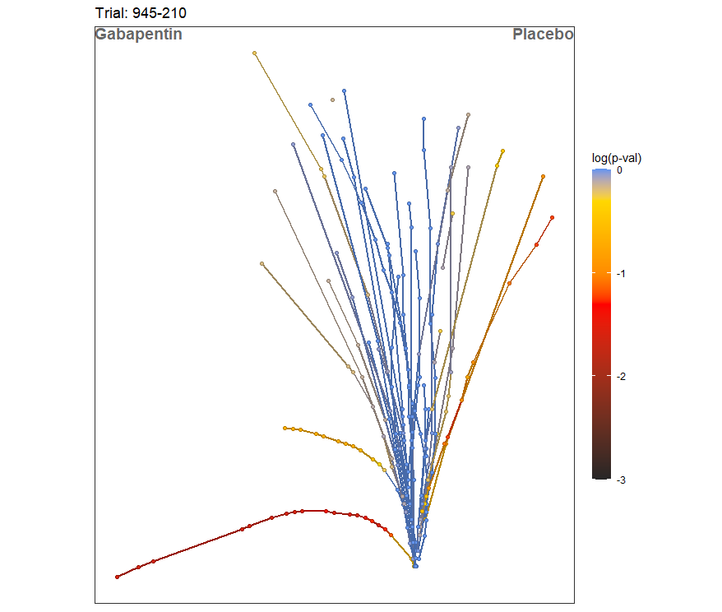
Tendril plot
Preferred terms
Timing of events
P-value
Absolute count overall
13
Notes:
A Tendril Plot presents all harms at the preferred term level that have at least 2 events as individual "tendrils" spreading outward from a central point which represents the point of randomization/assignment to the intervention. All Tendrils are made up of vectors that have a length and a direction. The length is the time between each event (i.e., longer duration = longer vector). The direction (left or right) is the arm in which the event happens (i.e., an event in the intervention arm will angle to the left). Each point represents an event and the colour indicates the adjusted p-value for that specific event.

Slide 14
Characteristics
Data structure (i.e., IPD vs. summary) required to produce visualization
Organization of harms (i.e., preferred terms vs. higher order terms)
Dimensions of harms data
Absolute occurrence
Estimate by treatment group
Measure of effect
Precision of estimate
Significance of estimate
Severity of harms
Timing of harms
14
Notes:
For characteristics of these visualizations, we wanted to assess how they were originally proposed and how they could be modified to create a toolbox so that trialists would be able to easily find a visualization approach to meet their needs. These included how the data needed to be set up to produce each visualization, how the harms are organized, and all dimensions of harms data that are presented or could be presented with the visualization’s existing features.

Slide 15
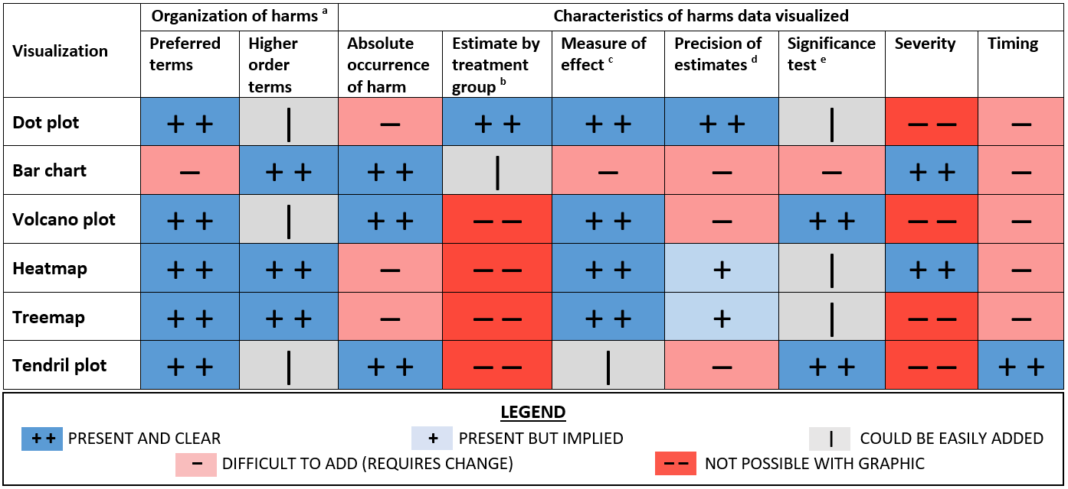
15
Notes:
The first part of our results for this comparison is a summary of our assessment of the characteristics of each visualization. I’m going to walk you through it using the Dot Plot and I wanted to remind everyone which visualization this is. It’s a presentation of all preferred terms with their risk in each group, a summary estimate of effect, and the precision of those estimates. (advance)
This is meant to be a reference table in which we tried to show for each visualization which characteristics were presented and which would require modification to include or not really be possible for the graphic. The symbols in this table represent a likert-scale for the presence of the characteristics.
The Dot Plot presents harms at the preferred term level but could include information about higher order terms with the addition of secondary axis labels. The Dot Plot shows the estimated risk of each event by treatment group, the estimated measure of effect, and the confidence interval around that estimate. The p-value or significance for each effect could be easily added by changing the colour of the point estimate. The absolute occurrence for each harm or timing could be added but they would require additional visualization elements to be added. It is not possible to show each harm’s severity distribution in the Dot Plot because each harm appears once.
As another example, for organization of harms, although any visualization could theoretically be produced at either level, most visualizations originally proposed presenting data on harms at the preferred term level, with the Bar Chart presenting harms at Higher order terms, and the Heatmap and Treemap presenting data on harms at both levels.
The takeaway from this slide is that no visualization is exactly alike to the others and they can also all be modified to some extent. Although we produced them as they were originally proposed for harms, no matter what the situation may be for a trial, it is likely that one of these approaches to visualizing harms data will be applicable and could be used to supplement the presentation of harms data in a publication.

Slide 16
How to assess value?
“[A measure of value] goes beyond the ability to support answering questions about data–it centers upon a visualization’s ability to convey a true understanding of the data, a more holistic broad and deep innate sense of the context and importance of the data in ‘the big picture’.”
Stasko 2014
16
Notes:
What is value and how did we asses it?

Slide 17
ICE-T Overview
Insight | Confidence | Essence | Timing
A visualization’s ability to spur and discover insights and/or insightful questions about the data | A visualization’s ability to generate confidence, knowledge, and trust about the data, its domain and context. | A visualization’s ability to convey an overall essence or take away sense of the data | A visualization’s ability to minimize the total time needed to answer a wide variety of questions about the data
Stasko 2014; Wall 2019
17
Notes:
To assess value, we adopted an heuristic framework from the data visualization literature called the ICE-T, an acronym for the four domains contributing to value: insight, confidence, essence, and timing
The goal of the ICE-T is not to replace traditional evaluations of specific details with large groups of representative stakeholders, but to complement existing evaluation techniques with a higher-level, value-driven assessment. The elements of the value framework combine to create a form that is useful in evaluating visualizations; particularly when there are multiple visualizations that are presenting the same data to see their relative strengths and weaknesses as determined by a small group of content experts.
As our content experts, we asked our author team and members of the Center for Clinical Trials and Evidence Synthesis, that our value would be assessed by Clinical trialists, Trial biostatisticians, Biomedical data visualization experts, and Pharmaco-epidemiologists. We modified the original ICE-T statements where necessary to fit our context and used Qualtrics to distribute and collect the responses.

Slide 18
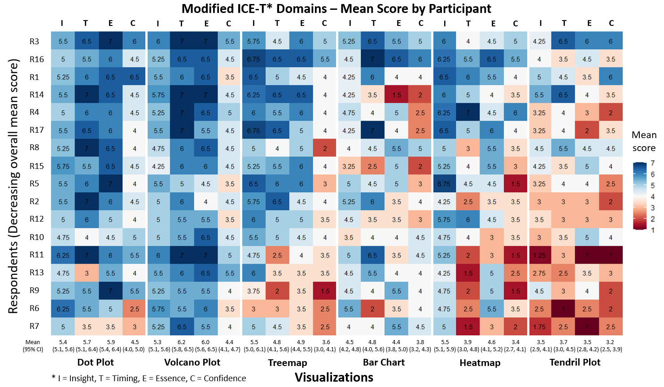
©2020 Johns Hopkins Bloomberg School of Public Health
Notes:
These are the results of or ICE-T value assessment. We had 17 responses, each of which is shown here, organized along the vertical axis from highest mean response to lowest mean response. The higher the score, blue color, the better the value
Dot Plot and Volcano Plot scored very well, particularly in the timing and essence domains, whereas the Tendril Plot scored poorly overall. The Treemap, Bar Chart, and Heatmap had average scores with a couple domains standing out as being potential avenues for improvement, namely the confidence in the data, which was the lowest scoring domain for all three, and also the timing for the heatmap as people thought it took a long time to understand.

Slide 19
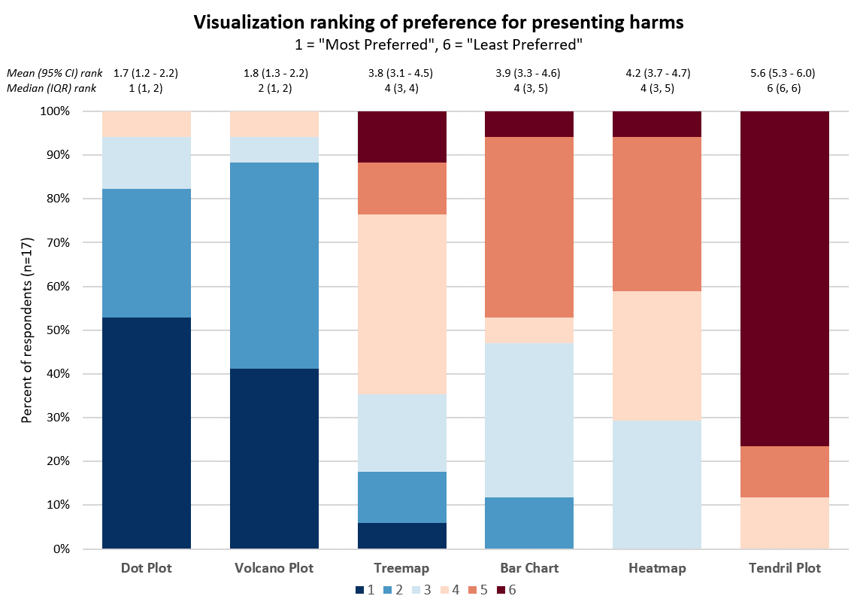
P = 0.05
19
Notes:
After our value assessment, we also asked our participants to rank their preference for visualizing a summary of harms and we can see that here as well, the Tendril Plot was ranked lowest and the least preferred; the Treemap, Bar Chart, and Heatmap having very similar distributions as mid-range options, and the Dot Plot and Volcano Plot have clearly scored highly as most preferred approaches. (advance) Here again is a reminder of which two visualizations those were.

Slide 20
Respondent thoughts
General: “There are a lot of values and it's difficult to interpret so many effects”
Volcano Plot: Display and duplication of information on multiple dimensions
Heatmap and Treemap: Lacking in clarity and challenging to read and interpret
Tendril Plot: “I find this way too challenging. Maybe a way to look at a few focused questions, but a terrible starting point”
20
Notes:
As part of our value assessment, we included a free-text question to capture any comments that respondents had about each visualization. Comments about the Dot Plot focused on the readability of the visualization given the number of harms and amount of data fit into the space, and comments about there being a lot of values and difficulty interpret many effects were actually common across the visualizations. The Bar Chart comments suggested that a better bar arrangement might be helpful to better understand the comparison and differences between the groups. Comments on the Volcano Plot did not have any common themes, but it was noted that there was duplication of information with multiple visualization elements representing the same dimension and that harms with the same set of data overlapped and “disappeared” from the visualization (i.e., two harms with the same number of events in both groups would occupy the same space on the figure). The comments on the Heatmap and treemap noted a lack of clarity in the direction of treatment effect and the information conveyed, suggesting that there may be too much information presented in one visualization, although the Treemap was noted as perhaps being a good holistic overview of the harms profile, even if lacking in precision. Lastly, the comments on the Tendril Plot focused on the need for labels for harms and the challenge in interpretation: “I find this way too challenging. Maybe a way to look at a few focused questions, but a terrible starting point.”

Slide 21
Conclusions
Visualizations can be overwhelming with too much data
Most promising visualizations: Dot Plot and Volcano Plot
Trialists should consider using visualizations to present harms data
We need to understand how visualizations can communicate harms to patients and other evidence users
21
Notes:
We set out to evaluate the characteristics and relative values of several approaches to visualizing harms.
We learned that although visualizations can mitigate the issue of selection criteria, they can become overwhelming if presenting too many harms.
The Dot Plot and Volcano Plot were favoured by content experts although there are other options that have different characteristics to suit trialists’ needs.
More research is needed to understand how visualizations can communicate harms to consumers and other evidence users. We are working on putting together a couple different grants in different settings that should help us to explore this further and from other stakeholders’ perspectives.

Slide 22
Thank you
Email: riaz.qureshi@cuanschutz.edu
22

